Slide 1
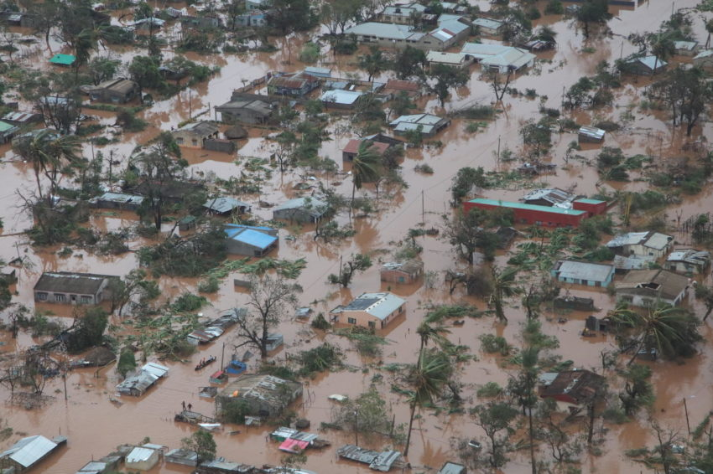
Mozambique
Photo: INGC

Slide 2
Prior to Cyclone Idai, 850,000 people were already in need of humanitarian assistance, mainly due to poor rainfall and the fall army worm (FAW) invasion
An estimated 1.78 million people (IPC phase 3 and above) were severely food insecure
Cyclone Idai
Cyclone Idai made landfall in Mozambique March 15, CAT-2 storm
1.85 million people affected
4 provinces and 50 districts affected
Cyclone Kenneth
Cyclone made landfall as CAT-4 on 25 April
First cyclone in the region - unprecedented event hitting an area where no cyclone since satellite era.
Cyclone Kenneth landfall in northern Mozambique April 25, 2019. The storm arrived only six weeks after Cyclone Idai
373,857 people in need of humanitarian assistance
2 provinces and 21 districts affected

Slide 3
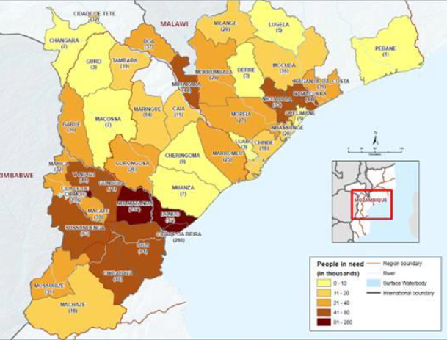
TC IDAI
TC KENNETH
Estimated number of people in need of food assistance by District (in thousands) – 24th March 2019

Slide 4
IMPACT OF TC IDAI
The agricultural sector:
severely affected in the Central Region.
433,056 affected households need seed assistance
The agriculture sector suffered the most losses with USD$513 million.
Growth likely to fall to 2.0% in 2019 (3.5% in 2018)
Food consumption of staples has been reduced by over 50%
Nutrition: 130,000 pregnant and lactating women are at risk of moderate malnutrition ; 100,000 Children 6-59 months are at risk of acute malnutrition
Poverty: 64% Poverty rate, may rise to 79% in affected areas
Inflation: destruction of crops => decline supply of agricultural products => increase price of food products in the central zone.
The impact of IDAI will increase multidimensional poverty
TC IDAI and TC KENNETH:
Emergency for livelihood – resilience response

Slide 5
FSC response
FSC coordinators present in the country before the events
Surge deployment of 2 staff + deployment of 2 SBP (IMO)
Remote support for the IM from Rome
FSC active in Maputo, Beira/Chimoio and Pemba
TC IDAI:
28 partners for food assistance and around 16 partners for livelihood recovery
FSC response in Beira: 1.8 million people reached in food assistance
Agro support: 21,416 households for beans & maize + support to horticulture: 84,000 families.
TC KENNETH:
3 partners responding in livelihood and 9 partners in food assistance
348,000 people reached by food assistance
Funding is low, especially for the recovery phase: TC IDAI: 54% ; TC KENNETH: 5% with limited perspective)

Slide 6
Key achievements:
First cluster to start activities on early recovery
Coordination of the seed distribution + seed protection
Cooked food distribution in school: coordination with education cluster
Involvement in agricultural need assessment
Joint training on distribution with shelter cluster
Issues / constraints:
Staff deployment – do we have the right strategy?
Volume of meetings: 70% of time in meeting
Questions
What is the role of the FSC and WFP food assistance
Need assessment results useful?

Slide 7
Partners observations - What Worked Well?
Overall coordination in Beira – EOC in the airport
Coordinators / IMOs did their best to respond to partners’ requests and questions (even remotely)
Information sharing (mailing lists)
Good articulation of gaps by the sector
Fast and efficient partners collaboration to mobilize resources and expand coverage
Government involvement and support
FS Partners currently involved the revision of the SoP for sudden onset disasters in Mozambique regarding targeting

Slide 8
Partners observations Challenges and Lessons Learned
FSC came late in the response – gFSC could have deployed earlier and also before the cyclone hit in a preparedness mode
Beira – the CC pulled out to cover other tasks, IMO alone
Low partners’ attendance to the cluster meetings in Beira.
Language of cluster (English) limits participation of the local organizations and Government authorities.
Absence of WFP from cluster meetings (in April)
Early Recovery WG : unclear why they were created as they are supposed to be phased out: significant overlap with FS and Shelter Clusters

Slide 9
Challenges and Lessons Learned cont’
Format of the meetings: Discussions seemed mostly focused on food distribution – not much space for any other kind of strategic discussion and partners updates
Difficulties in agreeing targeting and numbers with the government – the FSC could play a better role in mitigating this
Discussions on seed distribution came late in the response – hard to get info on areas/kit sizes etc (unclear seeds’ distribution plan)
Fatigue from communities needs assessments – too many agencies asking info
Challenges of sexual abuse linked with registration
Information on existing social protection system could have helped

Slide 10
Questions for the working groups
Based on the challenges identified in Mozambique (and on your experience as partners in other countries):
1. How do you think Food security coordination could be improved at Country level?
2. What type of support and improvements are needed at global level to effectively support FS country clusters?
3. Any specific recommendations for Mozambique? Has the FSC responded to the needs of the FSC partners in Mozambique?

Slide 11
Recommendations (shared by partners ahead of the meeting)
Specific to Mozambique
An efficient Contingency plan/preparedness plan ahead of the cyclone could have helped
Deploy Portuguese speakers in the field (or at least Spanish)
Info sharing: FSC to share more information on Government plans, FAO and UNDP for recovery and livelihoods support.
Improve engagement in Food Security and Livelihoods in urban context (Beira city).
Partners request FSC to remain active in Beira at least 1 year, until next main harvest in 2020.
Better coordination of partners on needs assessments

Slide 12
Recommendations (shared by partners ahead of the meeting)
General/Global
Lead Agencies need to be clear on Coordination functions and draw the line between coordination role and implementation in the field.
FSC role in this is key to mitigate competition among NGOs for partnering with WFP
Clearer leadership in the FSC – staff coming and going
If/When Early Recovery WG is created
FSC need to engage with them to clarify roles and responsibilities
Advocacy at global level to avoid creation of such WG

