Slide 1
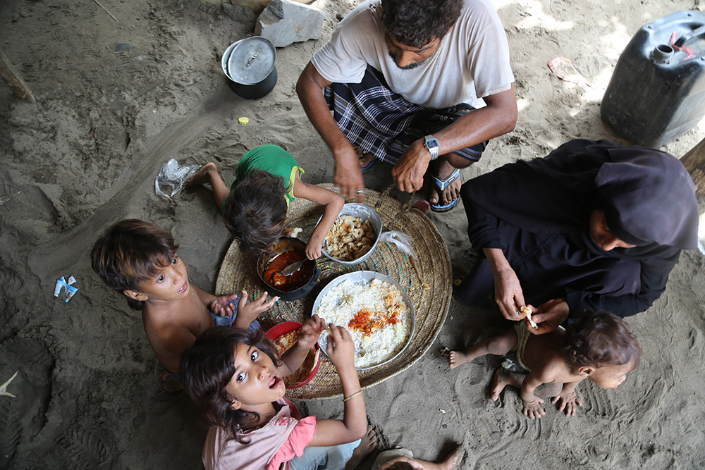
  GLOBAL
  PARTNERS
  MEETING
  23/24 May 2019
  Iraq Room, FAO, Rome

Slide 2
Overview
1
Global Overview
2
gFSC achievements against its objectives

Slide 3
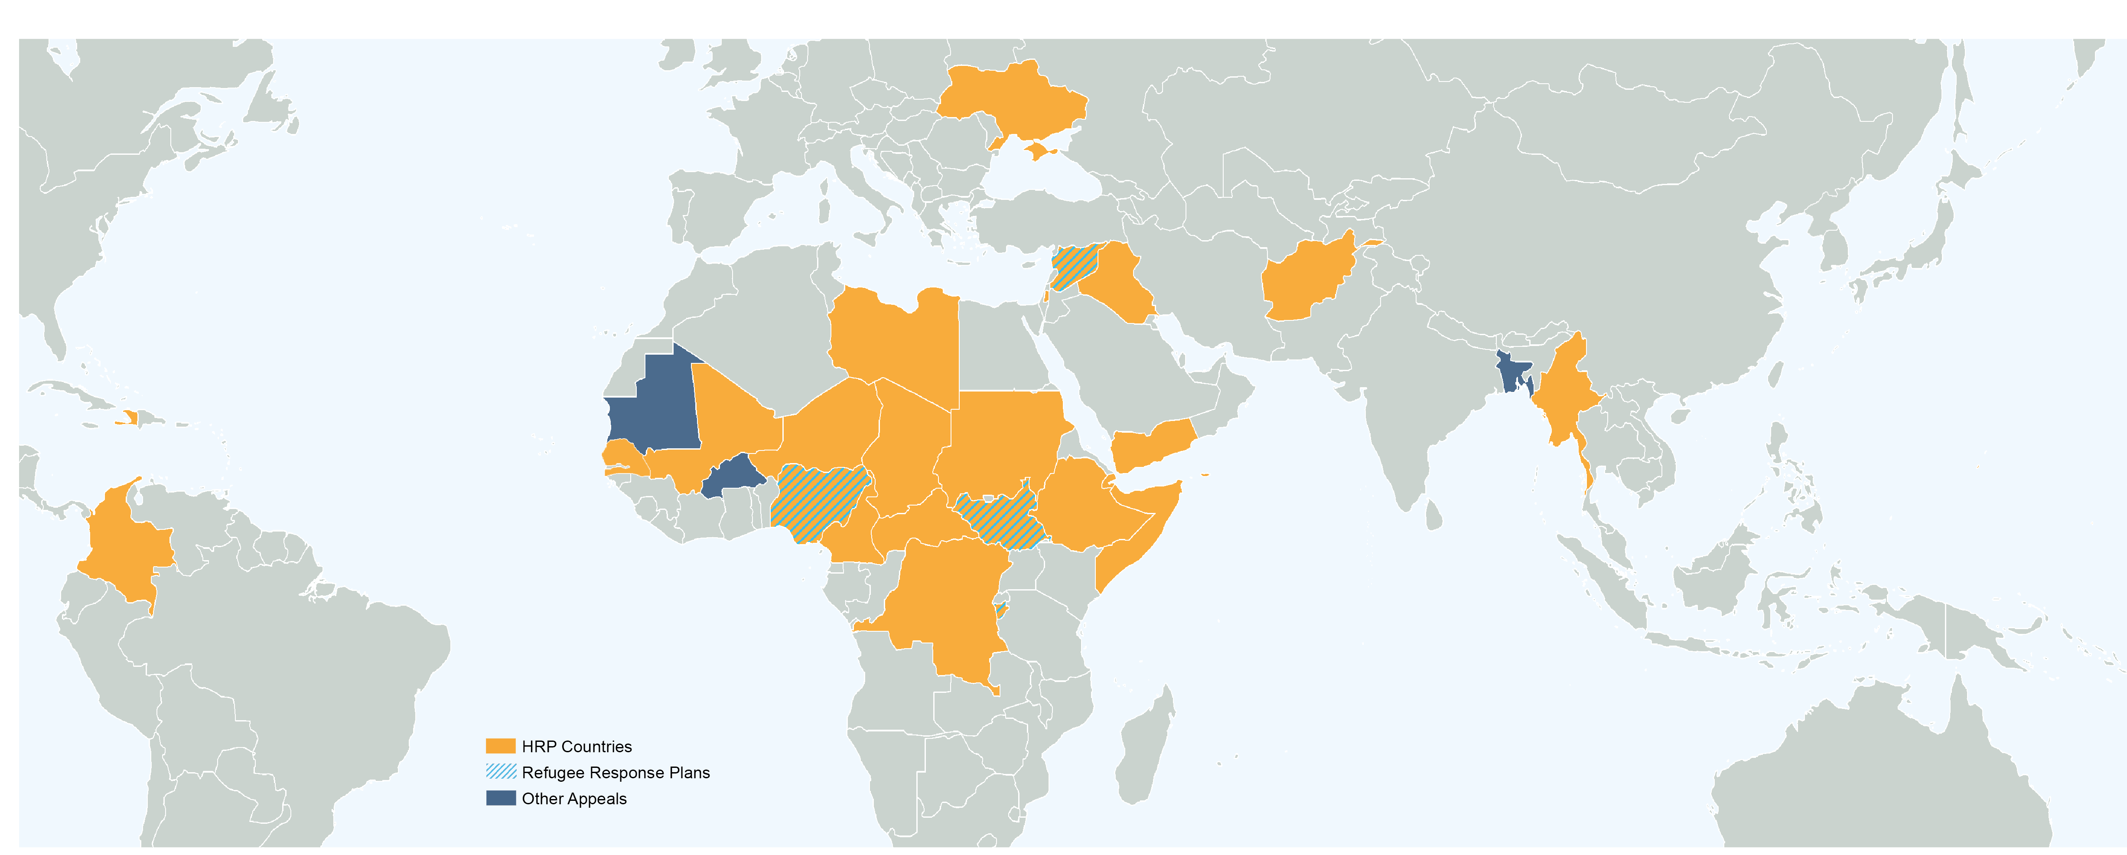

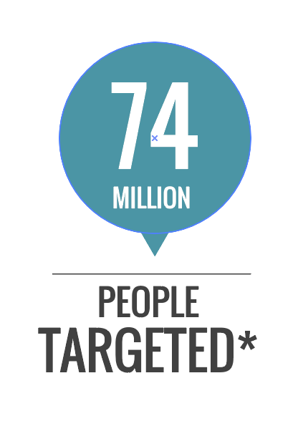
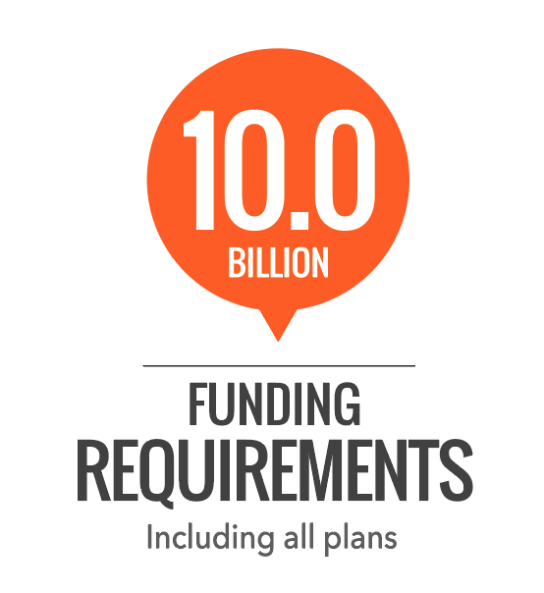
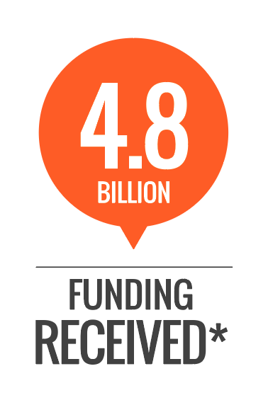
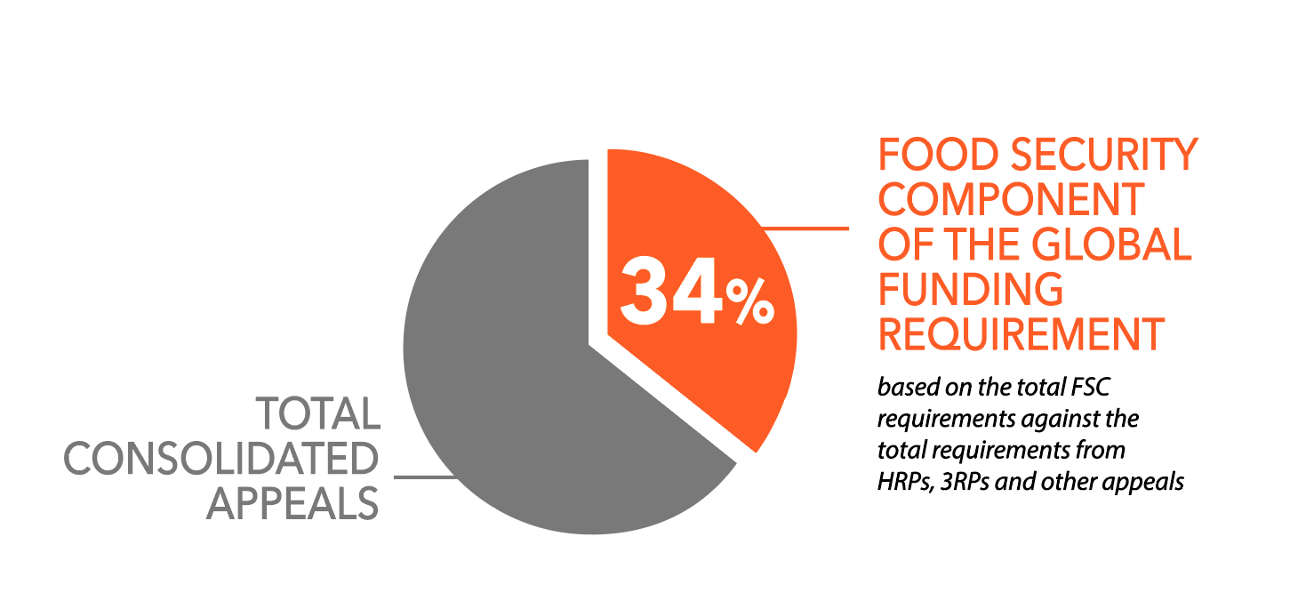

Food Security Clusters and Coordination Overview (last updated Jun 18)
Notes:
In 2018, the humanitarian community is collectively targeting 74 million people globally with both lifesaving and livelihoods food security assistance. There are 35 consolidated response plans involving FSC partners and national governments, with an overall value of US$ 10 billion for the food security sector alone. In light of limited resources and competing crises, partners are implementing activities tailored contextually, and are ensuring that inter-sectoral collaboration is streamlined particularly with the Nutrition and WASH Clusters. Protracted, conflict related crises in Syria, Yemen, South Sudan, Nigeria and Somalia remain as priorities, in addition to the unfolding crises of the Sahel. Food Security responses account for almost 34% of the overall global appeal in 2018.

Slide 4
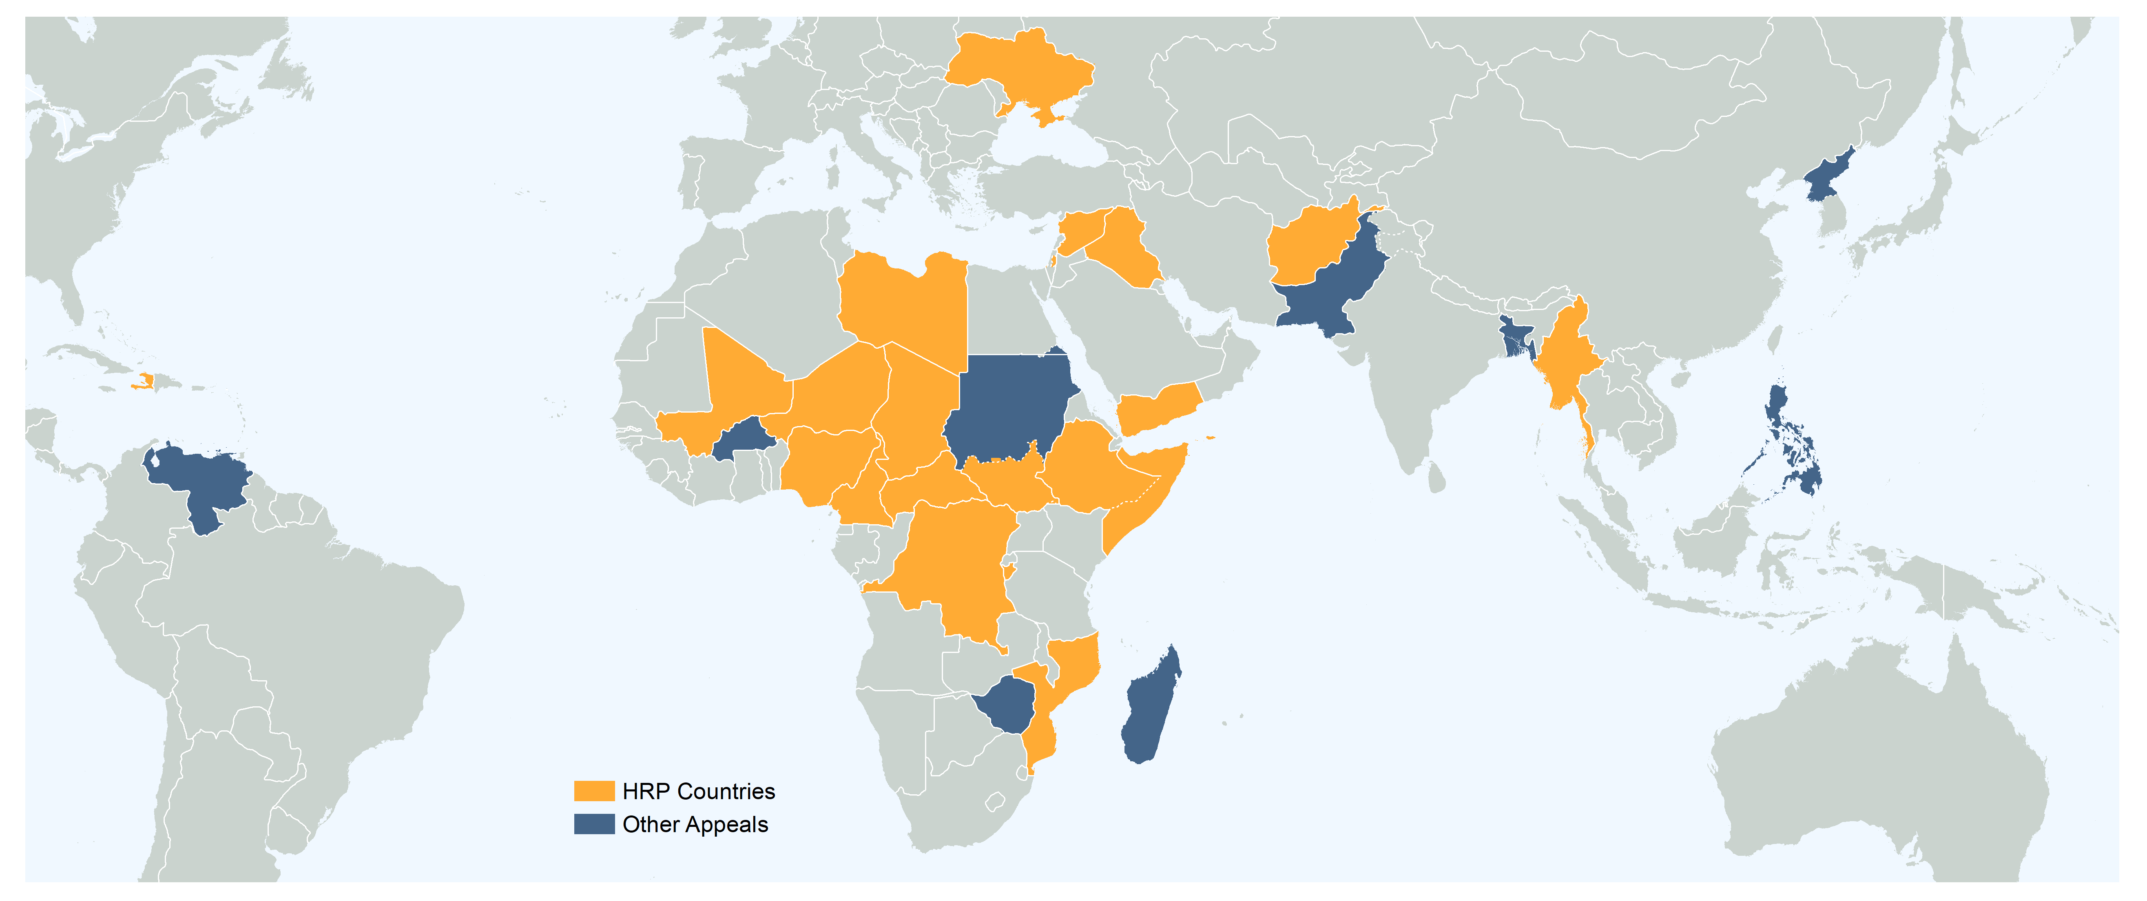
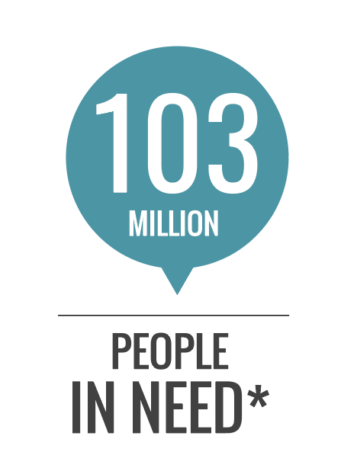
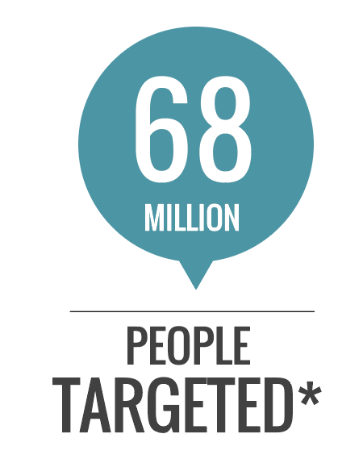
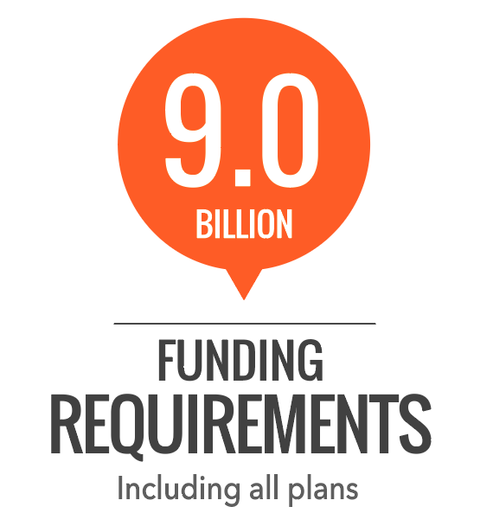
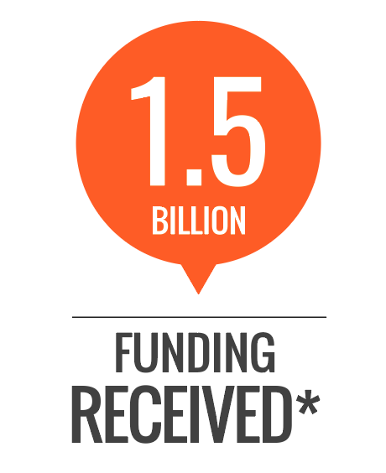
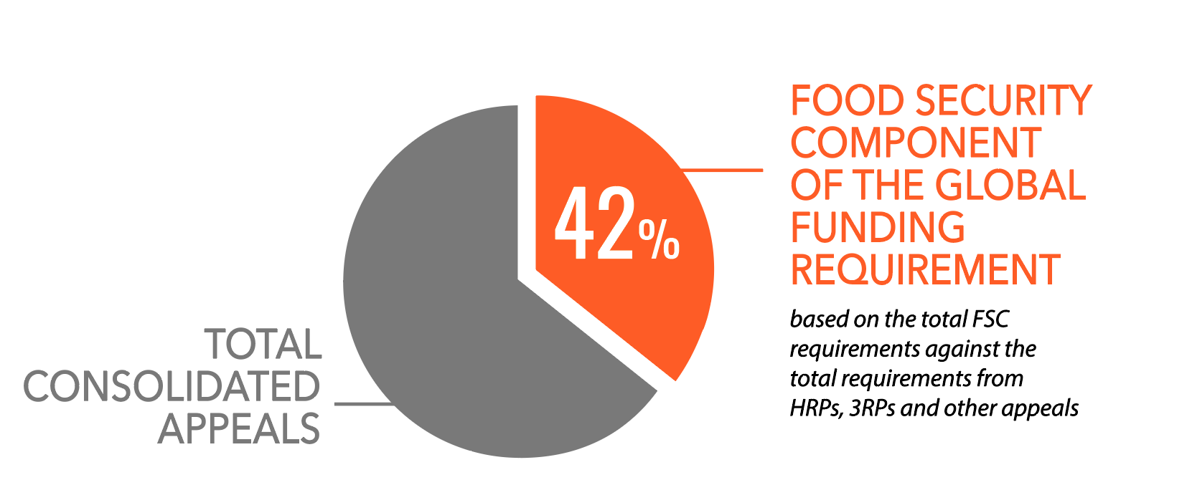
Food Security Clusters and Coordination Overview (last updated May 2019)
Notes:
In 2019, the humanitarian community is collectively targeting 68 million people globally with both lifesaving and livelihoods food security assistance. There are 28 consolidated response plans involving FSC partners and national governments, with an overall value of USD 9 billion for the food security sector alone. In light of limited resources and competing crises, partners are implementing activities tailored contextually, and are ensuring that inter-sectoral collaboration is streamlined particularly with the Nutrition, Health and WASH Clusters. Protracted, conflict related crises in Syria, Yemen, South Sudan, Nigeria and Somalia remain as priorities, in addition to the unfolding crises of Mozambique, Zimbabwe, Malawi, Comoros, Burkina Faso, Venezuela. Food Security responses account for almost 42% of the overall global appeal in 2019.

Slide 5
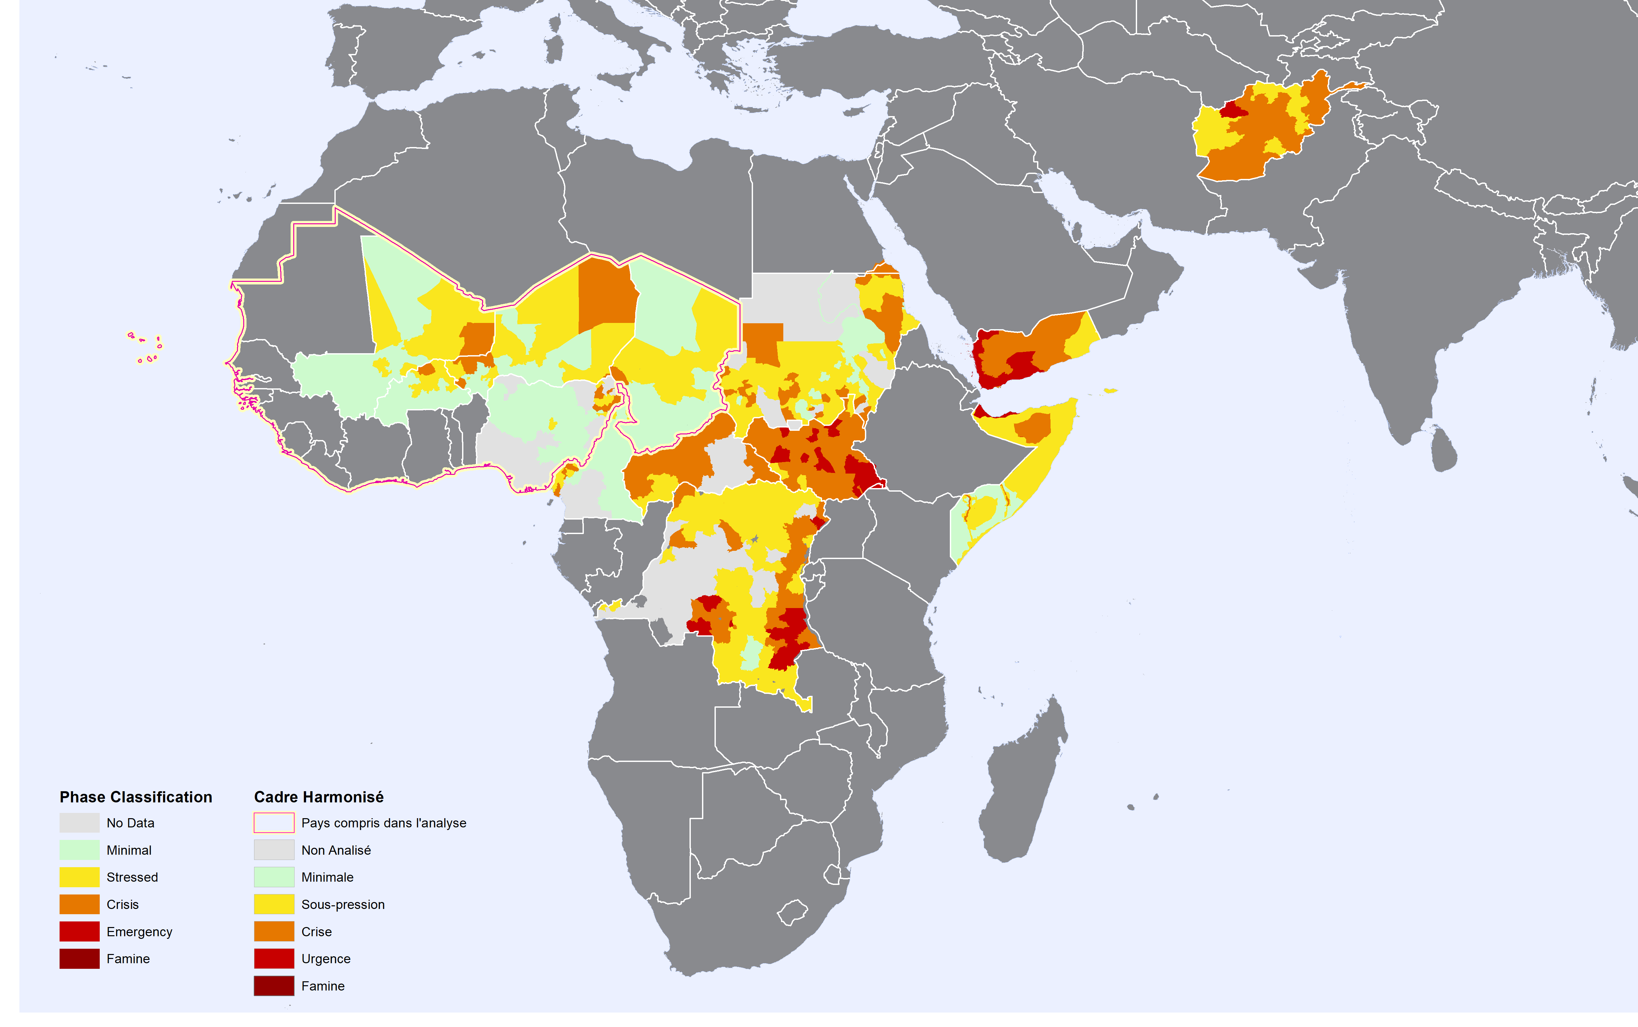
Global IPC Map (December 2018 - May 2019)
Notes:
Major changes in Nigeria, S. Sudan and Somalia

Slide 6
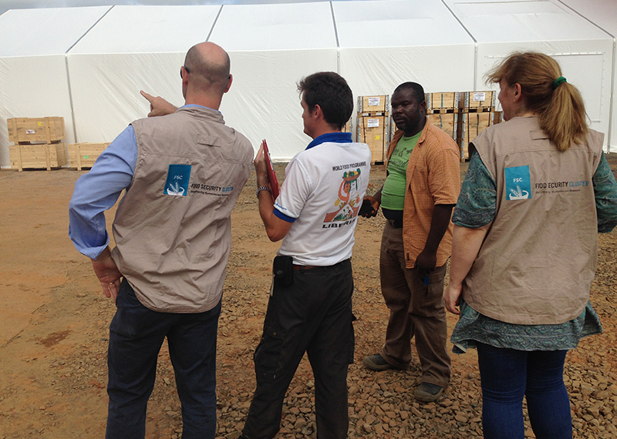
  Achievements against gFSC work plan
  objectives

Slide 7
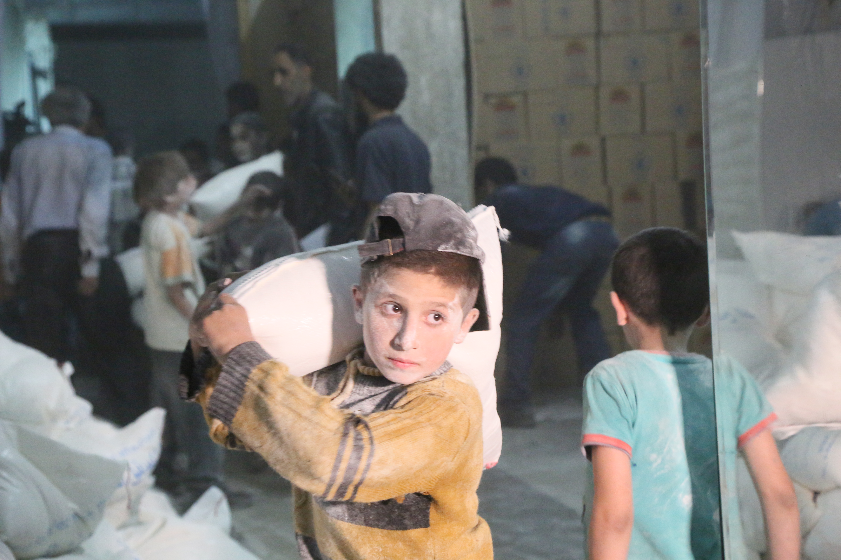
How do we work to deliver?
^{gFSC STRATEGIC PLAN 2017-2019}
Effective food security coordination at country level
Partnerships and collaborative initiatives at global level
Advocacy, communication, resource mobilization, humanitarian systems
Programmatic coordination action

Slide 8
RESULT ONE
Effective food security coordination
at country level
Country Clusters Backstopping and Surge Support
IM systems
Trainings
Support to country cluster
Partnership & strategic meetings
Effective Food Security Country Coordination
Performance monitoring (CCPM)

Slide 9
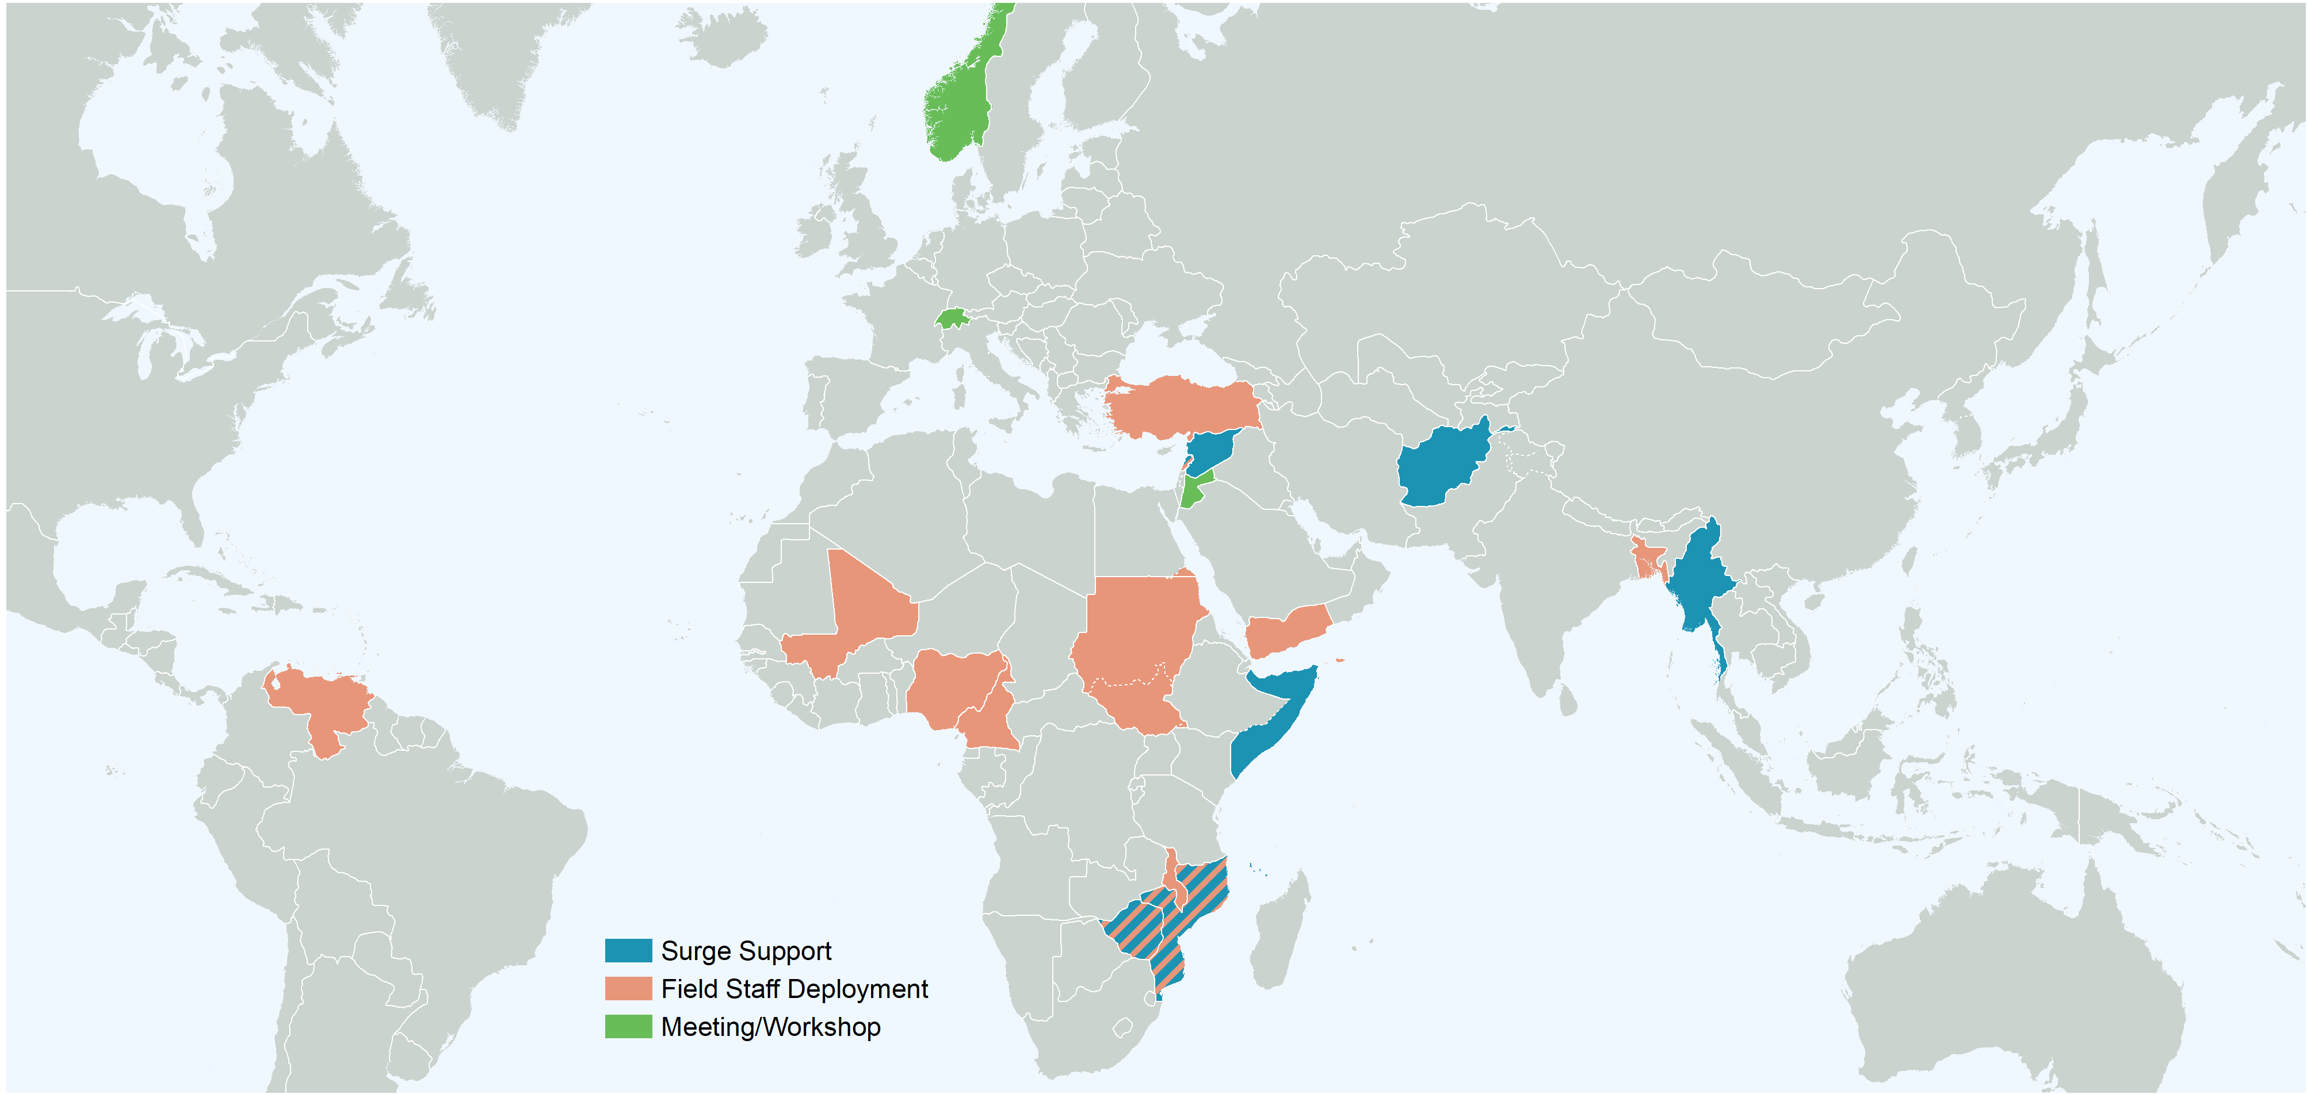
Country Clusters Backstopping
and Surge Support (Dec 2018-May 2019) 2019)
118
DAYS of gST MISSIONS
4
TRAININGS/
RETREATS
12
INFORMATION MANAGERS DEPLOYED
11
CLUSTER COORDINATORS DEPLOYED
Notes:
Compared to what has been done in 2018:
- 109 Days of mission form the gST
- 6 Trainings and Retreats
- 15 CCs deployed
- 8 IMOs deployed

Slide 10
Support to country cluster (staffing, rosters, support missions) / Dec 2018-May 2019
Support Missions | # days in Country
Afghanistan | 5 days
Comoros | 6 days
Lebanon | 4 days
Mozambique | 71 days
Myanmar | 5 days
Zimbabwe | 5 days
Tot. | 95 days
Support with deployments | # Staff (CC and IM)
Bangladesh | 2
Cameroon | 2
Lebanon | 2
Malawi | 1
Mali | 1
Mozambique | 4
Nigeria | 3
South Sudan | 1
Sudan | 1
Whole of Syria | 2
Yemen | 1
Zimbabwe | 2
Venezuela | 1
Tot. | 23
Trainings/ Retreats | Period
Beirut | 15 days
Whole of Syria | 1 days
Tot. | 16 days

Slide 11
Trainings: Delivering Core Cluster Functions at Country Level
Activity | When | No. part. | Women | Men
IM training (English) – Beirut | 1-4 April 2019 | 15 | 5 | 10
IM training (French) – Beirut | 15-18 April 2019 | 14 | 2 | 12
CC/IM Retreat (English) - Beirut | 7-9 May 2019 | 17 | 5 | 12
CC Training (English) - Beirut | 25-28 March 2019 | 23 | 5 | 18
 | TOTAL | 69 | 17 | 52

Slide 12

Effective Food Security Country Coordination
IM/CC Retreats
For 2019 the gFSC implemented 1 CC/IMO Retreats. Another one is planned to happen in June.
The meeting is focused on sharing information and building a common understanding on how to mainstream and apply the New Way of Working in cluster’s activities.
9
CCs
1
retreat
17
participants
8
IMOs
BEIRUT
From
7 Countries

Slide 13
Partnership & strategic meetings
Other missions & Global level meetings
Information Management Working Group – Geneva
Humanitarian Network and Partnerships Week - Geneva
JIAF Consultation with the Global Clusters - Geneva
JIAF Workshop - Development of the Severity Model Measurement - Geneva
GBV Guidance Workshop - Geneva
Cashcap Steering Committee Meeting - Oslo
Famine Action Mechanism - Amman
Protection Workshop - Rome
Grand Bargain Cash Work Stream - Rome
  Missions Seven Global level meetings

Slide 14
Performance monitoring (CCPM)
Cluster Coordination Performance Monitoring _ Phases
PLANNING PHASE
SURVEY
ANALYSIS & ACTION PLANNING MEETING
FOLLOWING UP & MONITORING
Sept to Dec 2018
Dec 2018
As of 20 May 2019 16/ 26 countries finalized the survey
Waiting for results from country-level clusters/sectors

Slide 15
RESULT TWO
Partnerships and collaborative initiatives at global level
Technical working groups
Partners membership

Slide 16
Technical Working Groups 2019 Achievements
Inter-Cluster Nutrition Working Group | Finalization and roll out of the Inter-Cluster Nutrition Training Package
Preparedness and Resilience Working Group | Production of a glossary on preparedness and resilience terms
Programme Quality Working Group | Finalization of the methodology catalogue for Food Security and Livelihoods assessments
Cash and Markets Working Group | Development of a draft document on reporting multipurpose cash in FSL clusters/sectors and webinars

Slide 17
Partners membership
18 Partners applied for membership in 2019
63
Current
Members
56
Members
applied

Slide 18
RESULT THREE
Advocacy, communication, resource mobilization, humanitarian systems
Advocacy
Humanitarian Development Peace Nexus
Visual Communication

Slide 19
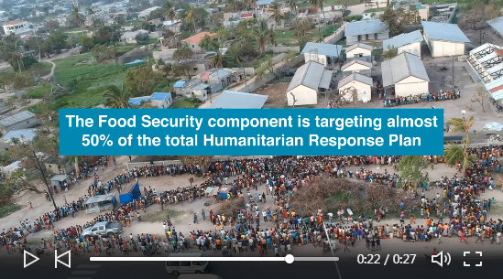
Advocacy, Comm., Resource Mobilization, Humanitarian Systems
Key Products
Cyclone Idai: one month on. (Video Story)
Notes:
Key products: Cyclone Idai one month later

Slide 20



Advocacy, Comm., Resource Mobilization, Guidance Documents
Key Products
Global Report on Food Crises 2019
Update of best Practices of FSC/S on mainstreaming of cross cutting issues
FSC annual report

Slide 21
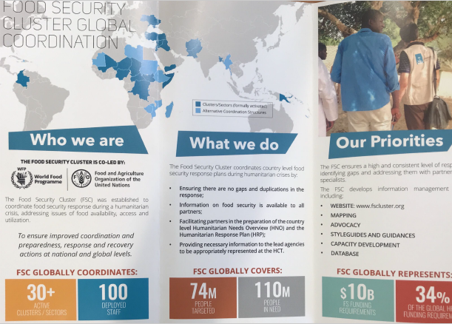
Advocacy, Comm., Resource Mobilization, Guidance Documents
Visibility for interagency/inter-cluster events

Slide 22
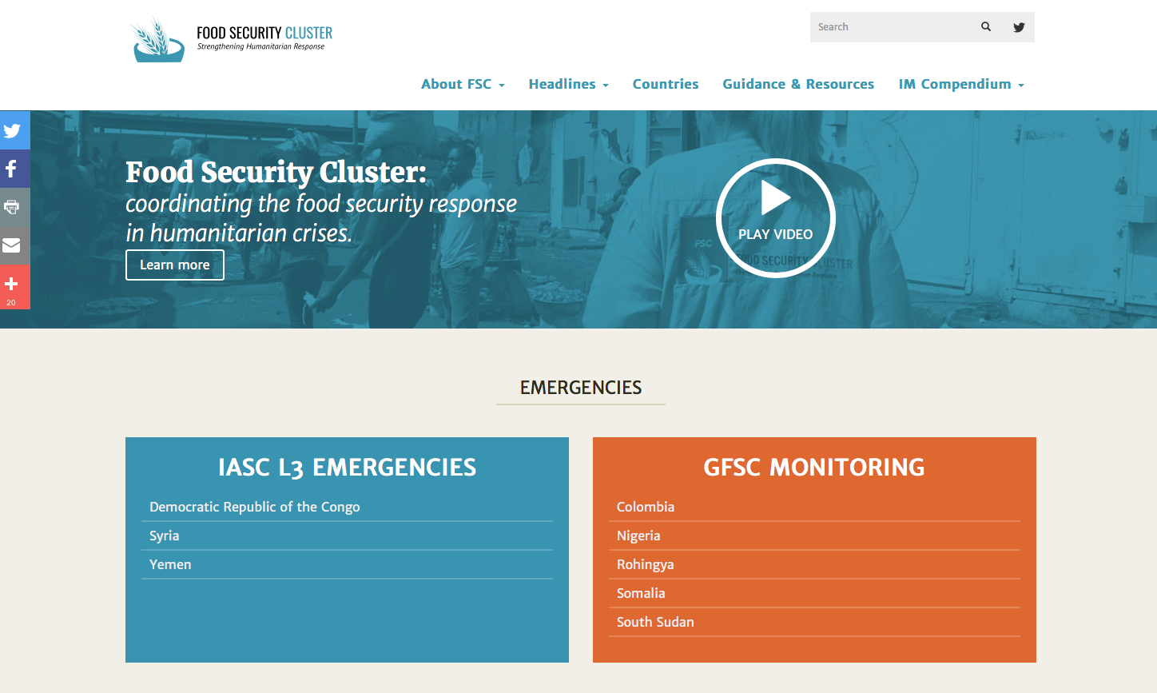

Website and social media
Comprehensive
Website
3.174
Total followers
873
New followers
2000
49
Newsletter
Subscribers
every 3 months
Average monthly
New followers
Website Key areas:
Emergencies and Monitoring
Country pages
Guidance & Resources documents
Training and e-learning (e-learning launched in Jan 18)
Notes:
Twitter followers have grown to be almost 3000, an average of about 70 new a month

Slide 23
RESULT FOUR
Programmatic coordination action
Joint and impartial needs analysis (ECHO funded)
Humanitarian Development Peace nexus
Integrated Nutrition Training Material

Slide 24
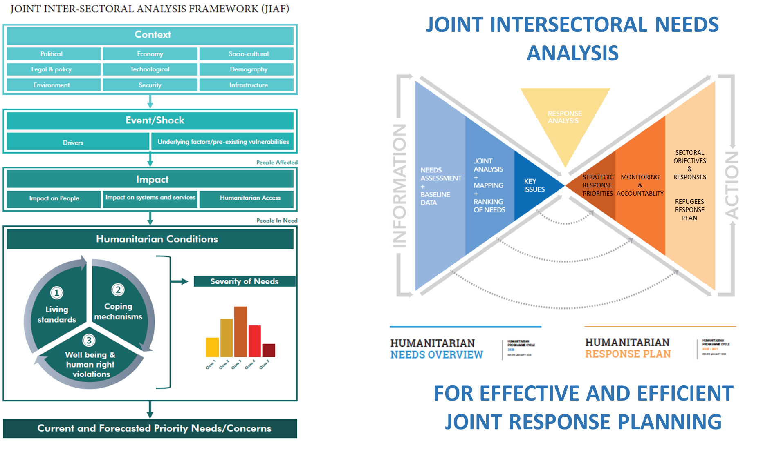
Joint inter-sectoral needs analysis
Notes:
Inter-sectoral needs analysis seeks to understand the extent to which various sectoral needs coexist within the same population groups and/or areas and how sectoral needs and associated factors correlate, thereby aggravating (or mitigating) the problem. A better understanding of the interplay of these dimensions is expected to lead the way to a better prioritization, targeting and quality improvements of Humanitarian Needs Overviews (HNOs) and Humanitarian Responses Plans (HRPs) across sectors: ensuring that the right type of assistance reaches the right people at the right time and leaves no one behind.

Slide 25
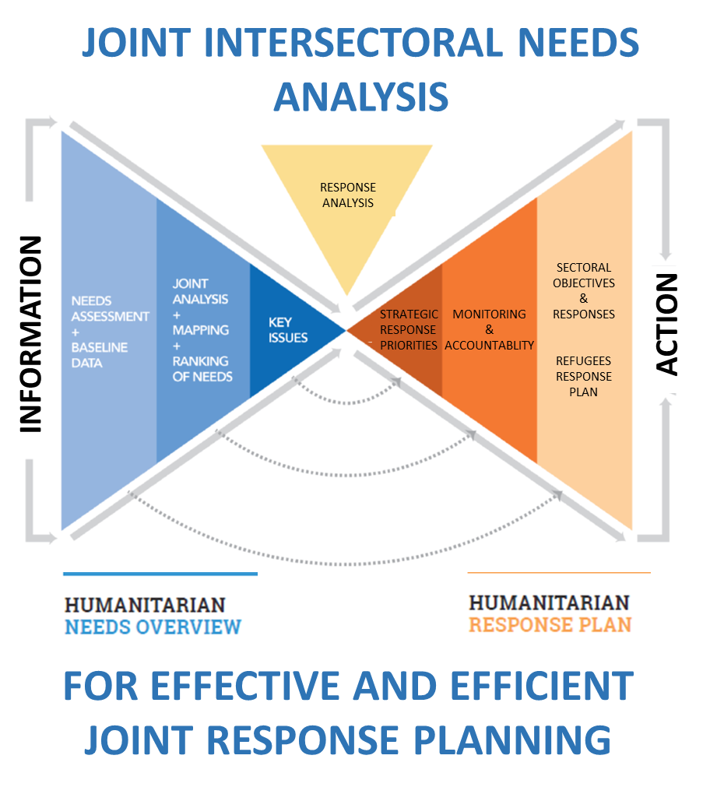
Joint inter-sectoral needs analysis
Notes:
Inter-sectoral needs analysis seeks to understand the extent to which various sectoral needs coexist within the same population groups and/or areas and how sectoral needs and associated factors correlate, thereby aggravating (or mitigating) the problem. A better understanding of the interplay of these dimensions is expected to lead the way to a better prioritization, targeting and quality improvements of Humanitarian Needs Overviews (HNOs) and Humanitarian Responses Plans (HRPs) across sectors: ensuring that the right type of assistance reaches the right people at the right time and leaves no one behind.

Slide 26
Joint inter-sectoral needs analysis
Project achievements to date:
COMPLETION OF THE 1ST COMPREHENSIVE REVIEW OF ALL MULTISECTOR NEEDS ANALYSIS
FINALIZATION OF THE JIAF CONCEPTUAL FRAMEWORK
FIELD TESTING OF THE JIAF CONCEPTUAL FRAMEWORK IN SUPPORT OF HUMANITARIAN NEEDS OVERVIEWS IN NIGERIA, CAR AND MALI
  BEGAN DEVELOPING AND STANDARDIZING JIAF ANALYSIS METHODS AND PACKAGE
  REFERENCE TO THE JIAF APPROACH IN THE OCHA 2020 NEW REVISED FORMAT/APPROACH OF THE HNO - AND THE HRP TO SOME EXTENT

Slide 27
Joint inter-sectoral needs analysis
Way forward:
FINALIZATION
Awareness and building acceptance of the methodology
Guidance and tools to support in-country Inter-Cluster Coordination Working Groups
VALIDATION
Further field testing, comprehensive peer review, feedback and lessons learned
FACILITATION
JIAF adoption by a wide-ranging array of stakeholders
Institutionalization of the JIAF package
Notes:
Stakeholders (UN agencies, NGOs, Civil Society Organizations, Governments, donors, academia, Clusters leadership, etc.)

Slide 28
Effective Global Food Security Coordination
gFSC Staff
1 Coordinator
1 Senior Programme Policy Officer
1 Administrative Assistant
1 FAO P4 Programme Officer
1 Programme Adviser
2 Programme Officer Consultant
2,5 Consultants
1 Consultant (EU Project)
1 Consultant (SBP)
1 Business assistant
1 NGO Secondment
1 JPO
1 WFP P4 Programme Officer
11,5
CURRENT
STAFF
4 Vacants
Notes:
1 Coordinator (Bruno)
1 Senior Programme Policy Officer (Jerry)
1 Administrative Assistants (Nancy)
1 FAO P4 Programme Officer (Damien)
1 Programme Adviser (Valentina)
1 Programme Officer (Riccardo)
1 Programme office consultant
2,5 Consultants (mattia, eleonora, walter)
1 Consultant (EU Project) guy
1 Consultant SBP (Gael)

Slide 29


  THANK
  YOU!
  W: www.fscluster.org
  E: info@fscluster.org
  @FSCluster
  Youtube

