Slide 1
Global Clusters Coordination Group
Food Security Cluster Global Partners meeting
Rome, 23-24 May 2019

Slide 2
GCCG in a nutshell…
Created in 2014 – all 11 global cluster coordinators are members
Monthly meetings
Main objectives: field support to clusters and inter cluster groups; guidance development and support; joint advocacy – where required from field colleagues
With the IASC restructuring, the GCCG is one of the IASC associated entities
GCCG interacts with IASC bodies (EDG; OPAG, Results Groups), via the IASC Secretariat. Modalities of engagement and accountability lines are being defined

Slide 3
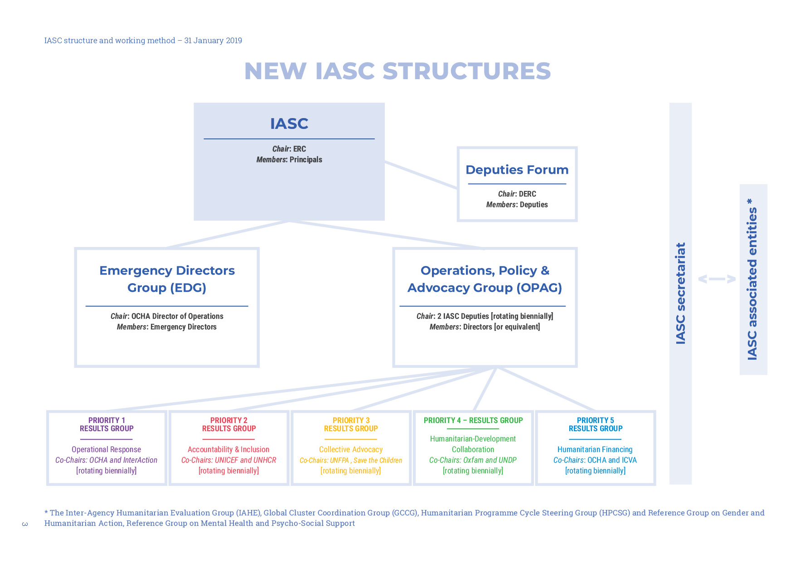
IASC STRUCTURES
Notes:
IASC Principals
Executive heads level, chaired by the ERC
Meets twice a year and on ad hoc basis
Strategic decisions on operational/policy issues
Deputies Forum
Representatives at the ASG level (or equivalent) of the IASC full members and standing invitees.
Meets on ad hoc basis as required
Informal platform for dialogue and information sharing on strategic issues of common interest.
OPAG
Senior representatives of the organizations, chaired by the NRC and WFP (rotational)
Meets once a year and on ad hoc basis as required
Provides policy support to the Principals
EDG
Emergency Directors, chaired by OCHA’s Director of Operations.
Focus on operations in acute humanitarian contexts
P2P
IASC RESULTS GROUPS
Results Group (focused on IASC priorities and as tasked by OPAG)
Each chaired by two Co-Chairs, reporting to OPAG (and EDG)
Entities Associated with the IASC
GCCG
IAHE SG
HPC SG
Gender RG
MHPSS RG

Slide 4
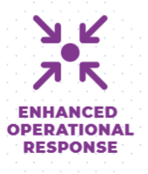
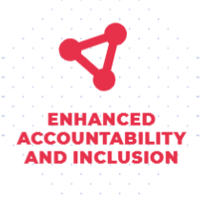
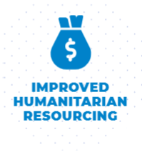
IASC Priorities (2019-2020)
Mainstreaming of Protection throughout the humanitarian response – looking at inclusion of agreed, specific and measurable indicators within cluster response and reviewing them within the midterm review process. Addressing bureaucratic impediments imposed on NGOs Strengthened humanitarian leadership
Humanitarian response informed and adapted by feedback from affected people. PSEA/SHA: awareness, prevention, reporting, addressing violations Guidelines on the inclusion of persons with disabilities in humanitarian action
Common narratives 2-3 contexts: humanitarian diplomacy strategy to address access and/ or protection challenges on the ground. Impact of counter terrorism measures on humanitarian action
Finalizing guidance on collective outcomes Capture and disseminate good practices on H-D collaboration Develop guidance on HDN and its linkages to peace, while safeguarding humanitarian principles.
Facilitating the development of innovative approaches to humanitarian financing. Mapping and promoting financing instruments supporting humanitarian interventions with development co-benefits Facilitate the simplification and harmonization of UN systems to reduce burdens and free additional resources for humanitarian operations.
Notes:
- Broad set of Strategic Priorities that cover the critical areas of work in humanitarian affairs.

Slide 5
GCCG main achievements in 2018
Revised CCPM guidance
Development of an ICCG performance monitoring tool – field testing
Joint workstreams GCCG-IMWG
Contribution to the HPC strengthening

Slide 6
HPC: Key changes
Multi-sectoral nature of needs and response required
Understanding causes, level of severity and link to development interventions
Better prioritization - groups or areas
Result-based strategic objectives defining changes we wish to see in the lives of people - impact
Importance of monitoring and inclusivity
Notes:
Key changes in the revised Humanitarian Programme Cycle approach
Increasing focus on the multi-sectoral nature of needs and multi-sectoral response required; the understanding of the causes (structural, chronic and immediate), the level of severity, and likely evolution to inform a more holistic and effective response, with linkages to development interventions;
Defining more concise response boundaries based on priority groups and/or geographic areas identified by the needs analysis; and formulating results-based strategic objectives that define the changes we wish to see in the lives of people and guide multi-sectoral and sectoral planning;
Establishing or improving monitoring systems that allow for ongoing analysis of changes of the situation and needs together with response achievements and satisfaction of those we serve to reflect how the humanitarian system is contributing to changes in the lives of people; and
Prioritizing inclusivity through disaggregation and/or analysis of the differential impacts of the crisis and associated needs for diverse groups of people (i.e. gender, age, disability and other diversity characteristics), and communicating with communities.
Impact and added value of the changes
These improvements will translate in more credible needs and severity assessments, and defensible priority responses and more transparent funding requirements. They will demonstrate how individual agencies and sectors/clusters have:
jointly cooperated to achieve a common understanding of people’s needs, comprehensive of their causes and individual vulnerabilities;
identified how the situation will likely evolve; and
defined strategic priorities and the most effective operational response that take into account the combination and variety of needs that people are facing.
For country teams, this will mean ensuring appropriate in-country analytical capacity at the cluster and/or agency level is available and dedicated; that data sharing and engagement in joint analysis is made a priority; and committing to more closely coordinated planning and response approaches which transcend what are too often sector silos.

Slide 7
Way forward – GCCG 2019 workplan
More focus on field support: where challenges and gaps in ICC and coordination structures; but also countries focusing on HDN and FAM + P2P
Support to field office for the roll-out of new HPC
Collection and analysis of data on humanitarian coordination architecture – for the EDG ARO and for constant updates on the Coordination architecture
GCCG engagement with new workstreams and partners (CE/AAP, Localization, Private Sector – how to engage with -, Donors - advocacy)
And…pending workstreams

