Slide 1
gFSC - SAG Meeting 13/07/20
AGENDA
Global Advocacy for food crisis
2. GHRP Update – Join data collection WFP/FAO
3. Update on Technical WGs:
Preparedness & resilience WG - Presentation of the survey results and decision on the way forward
4. AoB (New applications)

Slide 2
GHRP COVID-19

Slide 3
GHRP COVID-19 Overview
First GHRP (link here): USD 1B
Second May GHRP, including country plans: USD 6.7 B
Of which USD 1.4 B for food security
Third (and last) July GHRP: on going – to be published July 17
For food security requirements will be no less than USD 1.7 B
Main increases are:
Libya and Sudan: previously not included
Afghanistan, Cox Bazar, Lebanon, South Sudan
global FOOD SECURITY CLUSTER
YOUR COMPANY NAME

Slide 4
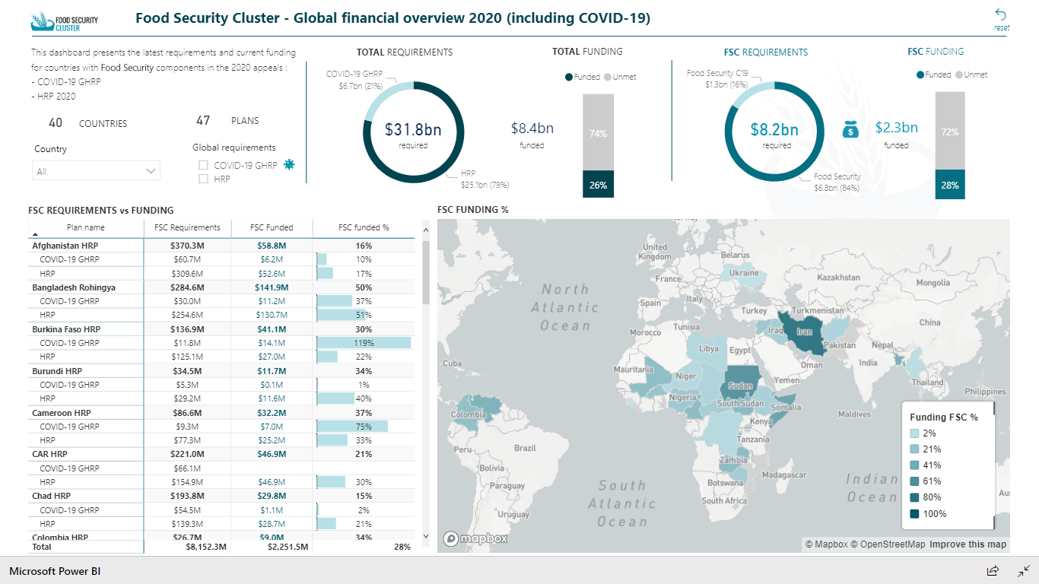
Global financial overview
Accessible here
global FOOD SECURITY CLUSTER
YOUR COMPANY NAME

Slide 5
How data is collected?
Accessible here
global FOOD SECURITY CLUSTER
YOUR COMPANY NAME

Slide 6
Preparedness and Resilience Working Group (PRWG)

Slide 7
PRWG Survey Background results
The Preparedness and Resilience Working Group (PRWG) was established in 2017 from the merging of two existing task teams on preparedness and resilience into a single TWG.
The aim of the PRWG is to guide and support in-country FSC and its partners on necessary preparedness and resilience building through the Humanitarian Programme Cycle (HPC).
The PRWG also aims at coordinating with inter-agency bodies, like the IASC and/or related INGO initiatives or networks, in operationalizing the guidance and tools relevant to food security
global FOOD SECURITY CLUSTER
YOUR COMPANY NAME

Slide 8
PRWG Survey Background results
Current Challenges:
Mandate and Scope
In addition to the core mandate (“ensuring a principled and coordinated humanitarian response”), the FSC has to support food security in transitional contexts
This means, to provide guidance and orientation on (1) early warning/early action, (2) emergency preparedness, (3) early recovery, and (4) resilience building
Points (1), (3), (4) are explicitly mentioned in the Strategic Plan 2020-2022
For the PRWG to cover all transitional contexts the scope is too wide, a focusing might be required
global FOOD SECURITY CLUSTER
YOUR COMPANY NAME

Slide 9
PRWG Survey Background results
Current Challenges: ​
Modus operandi - Options:
stand-alone WG (valuable space to exchange with others on work in progress), possibly with a reduced / more focused scope
task force(s) or focal points for each transitional context (EW-EA, EP, ER, RES), integrated into other WGs, who would collect information / knowledge and infuse it into the cluster work
Governance:
FSC partners could not commit to volunteer for the Chair/Co-Chair of a stand-alone PRWG
A survey was launched with global partners; results are intended to guide SAG's decision on the way forward for the PRWG
global FOOD SECURITY CLUSTER
YOUR COMPANY NAME

Slide 10
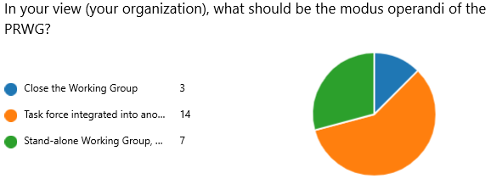
PRWG – Survey results
Modus Operandi:
Task force integrated into other WG: 14 responses
Stand-alone WG: 7 responses
To be closed: 3 responses
global FOOD SECURITY CLUSTER
YOUR COMPANY NAME
Notes:
24 responses
from 20 organizations (4 “doubles”)
All from partners, and one FSC CC

Slide 11
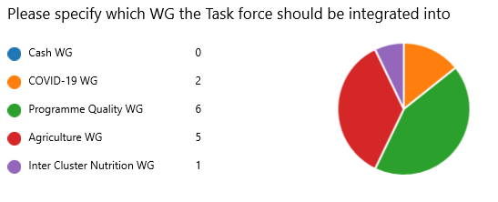
PRWG – Survey results
WG that could integrate this task force:
Programme Quality: 6 responses
Agriculture: 5 responses
C19: 2 responses
ICN: 1 response
global FOOD SECURITY CLUSTER
YOUR COMPANY NAME
Notes:
24 responses
from 20 organizations (4 “doubles”)
All from partners, and one FSC CC

Slide 12
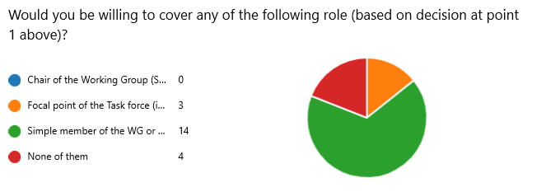
PRWG – Survey results
Willingness to cover any role:
Focal Point for the Task Force: 3 responses
Chair of the WG: none
Simple member: 14 responses
global FOOD SECURITY CLUSTER
YOUR COMPANY NAME
Notes:
24 responses
from 20 organizations (4 “doubles”)
All from partners, and one FSC CC

Slide 13
PRWG – Survey results
Modus Operandi:
Task force integrated into other WG: 14 responses
Stand-alone WG: 7 responses
To be closed: 3 responses
WG that could integrate this task force:
Programme Quality: 6 responses
Agriculture: 5 responses
C19: 2 responses
ICN: 1 response
Willingness to cover any role:
Focal Point for the Task Force: 3 responses
Chair of the WG: none
Simple member: 14 responses
global FOOD SECURITY CLUSTER
YOUR COMPANY NAME
Notes:
24 responses
from 20 organizations (4 “doubles”)
All from partners, and one FSC CC

Slide 14
AoB 13/07/20
New Applications:
1. LEGS: LEGS is a humanitarian standards initiative providing technical guidance and support on livestock-based programming in humanitarian response – applied as Associate
2. MUKTI (Bangladesh): Mukti Cox’s Bazar has started its journey at Cox’s Bazar district (Bangladesh) on 1996 as a non-government development organization Food Security, focus on poor and vulnerable women, livelihood in urban and rural areas of Cox’s Bazar and Chattogram district.

