Slide 1

Caracas, 24 of may 2019
Mauricio Pretto (mauricio.prettopereiraneves@fao.org)

Slide 2

Objectives of the Presentation
1
Context of the country
2
Context of the Sector
3
Work progress and next steps

Slide 3
  Context in Venezuela

Slide 4
General needs overview
1
According to the HNO, 7 million people are in need of humanitarian assistance in Venezuela and 3.6 million with food security needs.
An estimated 3,4 millions of Venezuelans have left their country because of generalized violence, persecution, and poor living conditions (10% of the total population and mostly active population ).
2
A family requires on average 23 minimum wages just to cover their basic monthly food expenses.
3
Notes:
4 – To mention that efforts are being done by all UN agencies and that the President is already accepting the word humanitarian. Progressively, the idea is being passed through Ministries.

Slide 5
Challenges of the Country
1
Low sovereignty in seed and food production
2
Government funds blocked in banks
3
Risk for the next planting season
Government is still in process to understand the emergency structure. The word Humanitarian is still not accepted in some circles
4
Notes:
1 – Seed scarcity and High price
4 – To mention that efforts are being done by all UN agencies and that the President is already accepting the word humanitarian. Progressively, the idea is being passed through Ministries.

Slide 6
  Implementation aspects

Slide 7
Positive aspects
1
Government is not against local production, increasing resilience and urban agriculture
There is a strong network of local organizations, more oriented to charity than to humanitarian standards, but with very good local and government acceptance; and technical skills.
2
Notes:
1 – I will also mention that the National Institute for Nutrition produces enriched food for children with locally accepted ingredients, which also reinforces production chains

Slide 8
Implementation challenges
1
Government is refusing to share data, and is resistant to data presented by other organizations. Negotiations are ongoing.
2
The hyperinflation, currency exchange policies, financial policies, cash scarcity makes it difficult for CBI
Partners, Agencies and Government are not used to emergency operations, they need training and mindset changes
3
Security situation is degrading, access to some areas are becoming increasingly difficult
4
Notes:
1 – There are many negotiations between UN and government to convince data sharing. The acceptance is improving.
2 – Here Caritas is doing a pilot in the use of Red Rose, and ACH is wanting to test the mechanism. Ideas of mechanisms are most welcome!
4 – In this one I will mention that armed groups are taking control of some territories, people and military are still afraid of humanitarian support.

Slide 9
Implementation challenges
1
The estimated inflation rate for 2019 is 10 million per cent.
Prices that are doubling every 26 days on average.
2
Blackouts, shortages in services and paralysation of the overall country infrastructure (only 8 working days in March 2019).
3
Humanitarian access : visibility, administration, politization of the aid, bank limitation…
4
Border closure : limitation on procurement, activities,…
Notes:
4 – To mention that efforts are being done by all UN agencies and that the President is already accepting the word humanitarian. Progressively, the idea is being passed through Ministries.

Slide 10
  FS Sector Perspectives

Slide 11
Perspectives
1
FS Sector is an opportunity; the opening of the sectors legitimizes and recognize our work (Humanitarian space)
Space needed for all stakeholders, including national and international organizations for better coordination, understanding of the needs and harmonization (technical space)
2

Slide 12
Perspectives
3
In terms of innovation, cluster provide the environment to discuss technical and operational problems and solutions.
Clusters are the interlocutors with the government, they can influence a more open and transparent international cooperation; and the establishment of international organizations to strength local actors mandated to provide humanitarian assistance.
4
5
Clusters promotes joint advocacy and are also a repository of Lessons Learned.

Slide 13
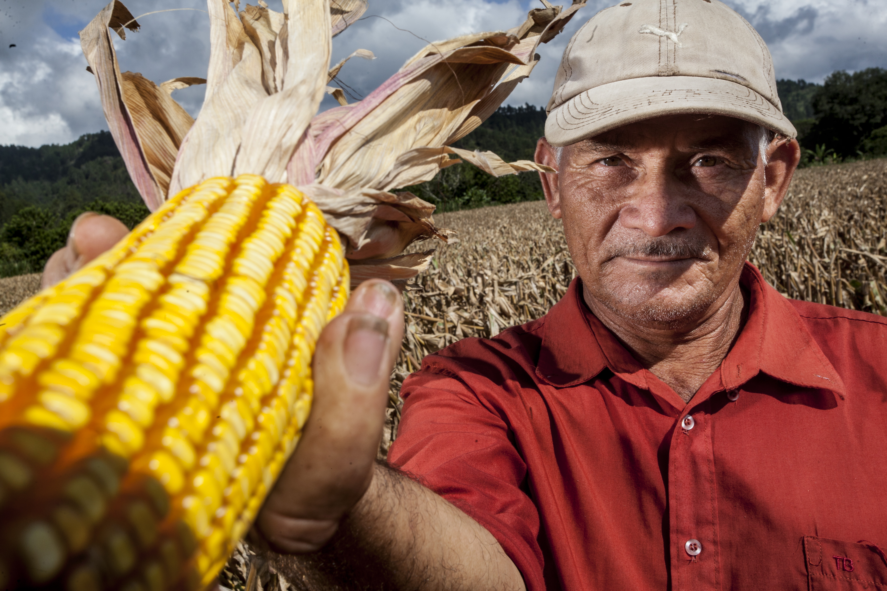
Muchas gracias!
Thank You!

